Slide 1
The event will begin momentarily.
This event is being recorded
Captions are available by clicking the CC icon in the Zoom toolbar below
ASL is provided
For more information and to download presentation materials visit: www.access-board.gov/av

Slide 2




Inclusive Design of Autonomous Vehicles: A Public Dialogue
Accessibility for Passengers with Mobility Disabilities: Part 2 Maneuvering and Securement

Slide 3
Agenda
Presentations
U. S. Access Board – Scott Windley
Robotics Research – Bryan Brillhart
Q & A
University of Michigan – Dr. Kathleen D. Klinich and Miriam A. Manary
Q & A
University at Buffalo – Dr. Jordana Maisel
Q & A
Open Dialogue
Dialogue continues online
https://transportationinnovation.ideascale.com/
PowerPoint slides available for download at:
www.access-board.gov/av

Slide 4
How to Participate
Ask Questions to Presenters
Submit questions using Zoom’s Q & A feature throughout the event
Ex. “Question - What are wheelchairs?“
Ex. “Question for Presenter 1 – Did your study look at scooters?”
Moderator will read question
May not get to all questions
Alternative: Email events@access-board.gov
Contribute to Open Discussion
Request to speak using Zoom’s Q & A feature
Ex. “Microphone - I’m Beth from XYZ Company and would like to talk about automated doors”
Ex. “Microphone - I’m Alex and I’d like to share my experience using an AV”
Host will enable your microphone
Moderator will call on you to unmute and speak
ASL – if you wish to be visible for signing, indicate in request
Online dialogue
http://transportationinnovation.ideascale.com/
For assistance, email: ePolicyWorks@dol.gov

Slide 5
Existing Accessibility Guidelines
ADA Accessibility Guidelines for Transportation Vehicles (1991, 1998)
www.access-board.gov/ada/vehicles
Updated Guidelines for Buses and Vans (2016) (not yet adopted by DOT)
www.access-board.gov/guidelines-standards/vehicles/update-buses-vans/guidelines-text
For technical assistance on these guidelines:
800-872-2253 (v)
800-993-2822 (tty)
ta@access-board.gov

Slide 6
U. S. Access Board: Accessibility Guidelines for Buses and Vans
Scott Windley, Accessibility Specialist

Slide 7
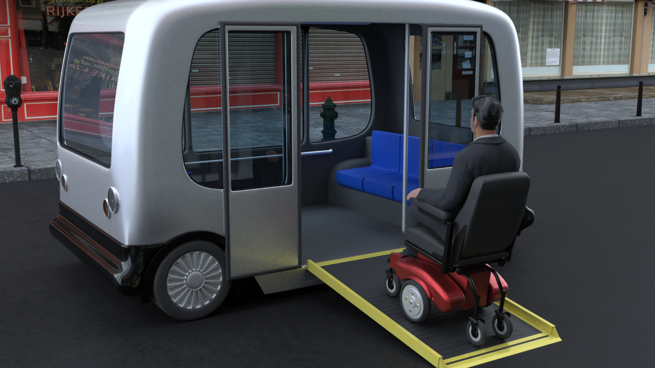
Boarding and Exiting

Slide 8
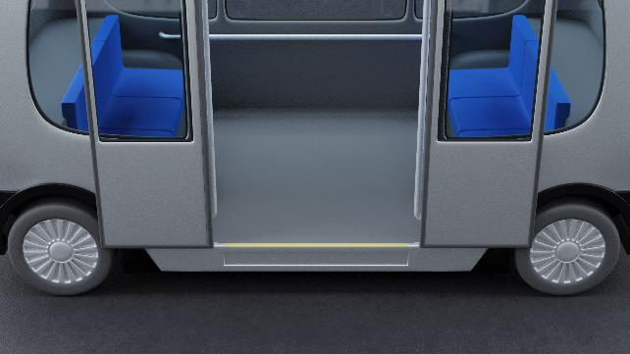
Technical Criteria
Walking Surfaces
Passenger Access Route
Maneuvering Through Vehicle
Securement Location Size
Means of Securement
Maneuvering and Securement
Maneuvering so that wheelchair users can get from door to securement space.
Means of securement.

Slide 9
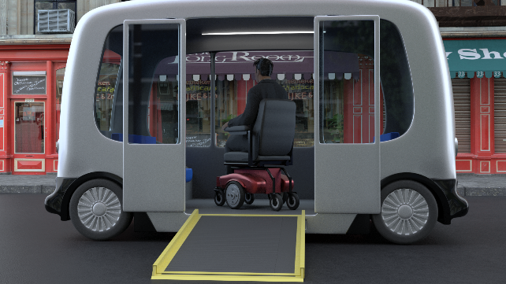
Maneuvering
Passenger Access Route
Sufficient clearances to permit passenger using a wheelchair to:
Get from doors to wheelchair space
Position for securement.
Back to doors for exit.

Slide 10
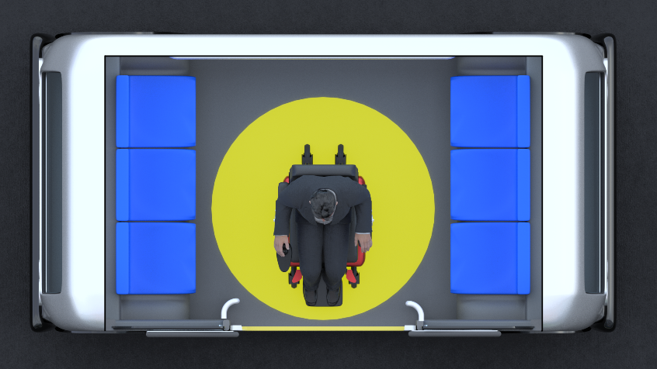
Recommendation
Turning Space
If there is room a turning space would provide greater maneuvering ability.

Slide 11
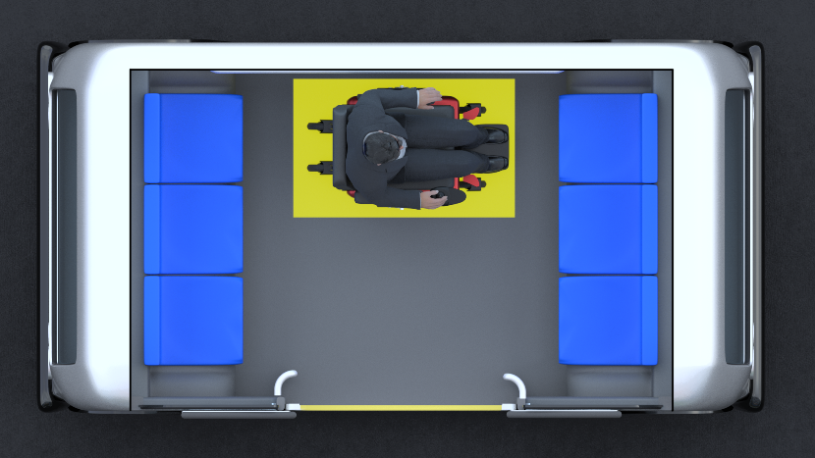
Wheelchair Location and Securement
One unobstructed side of each wheelchair space shall adjoin or overlap a passenger access route.
Wheelchair spaces shall be 30 inches min. width and 48 inches min. length.
Securement System (front facing).

Slide 12
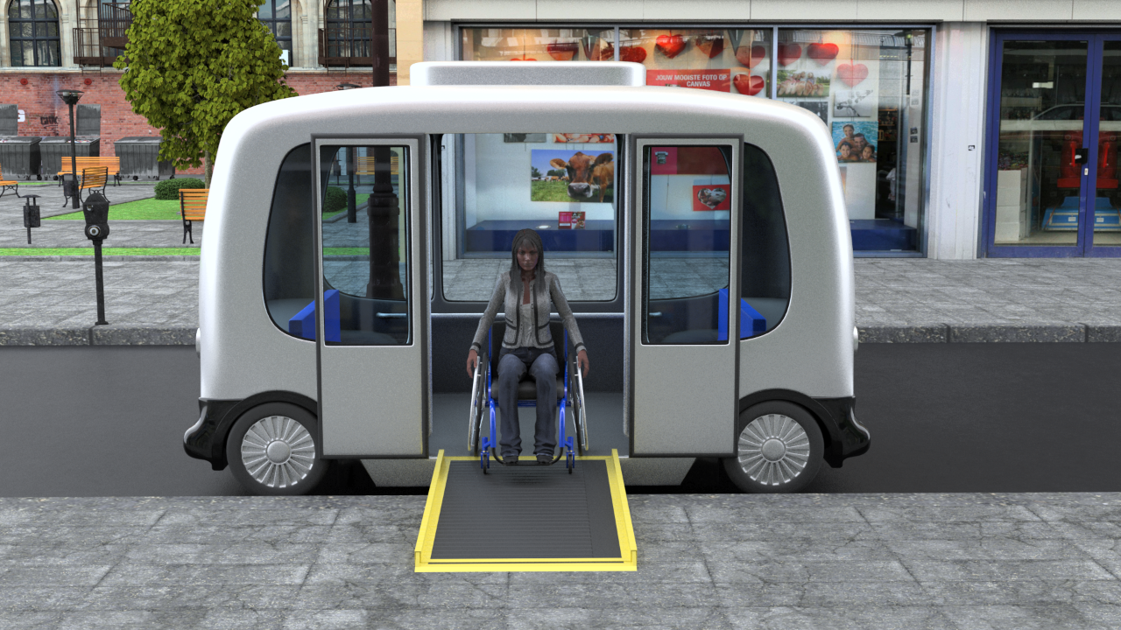
Maneuvering & Securement

Slide 13

Bryan Brillhart
Robotics Research

Slide 14
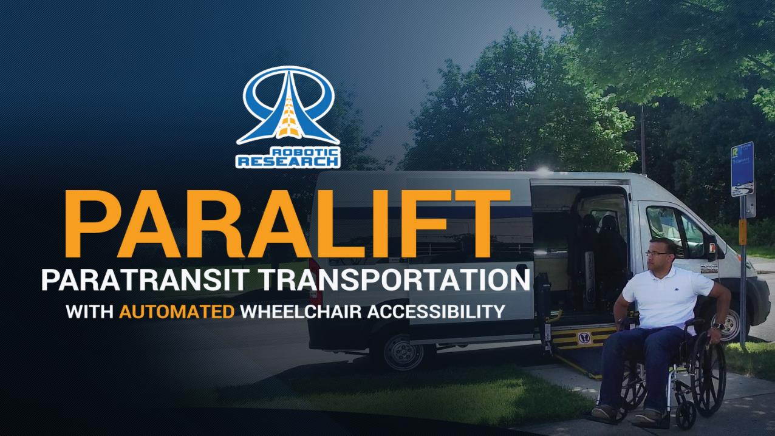
Paralift
®
Robotic Research Proprietary
14

Slide 15

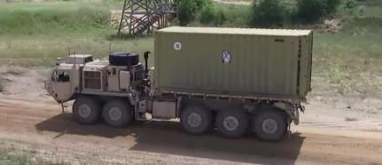
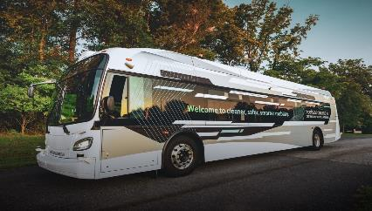
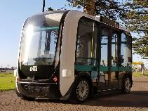
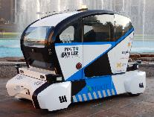
Robotics company with over 20 Years of experience in Unmanned Systems
Robotic Research has integrated autonomy on well over 20 different commercial and military vehicles for air, ground, and sea applications.
Since its founding in 2002, Robotic Research has been involved in most of the Army’s major autonomous vehicle programs and currently is the Autonomy Kit Prime Contractor for the largest Army autonomous vehicle projects, AGR and ExLF.
Robotic Research is leveraging its military technology for autonomous commercial transportation by teaming up with Local Motors, a leading innovator in Smart Mobility, and with New Flyer, the largest bus manufacturer in North America, and with Pratt & Miller, also known as Corvette Racing.

Slide 16
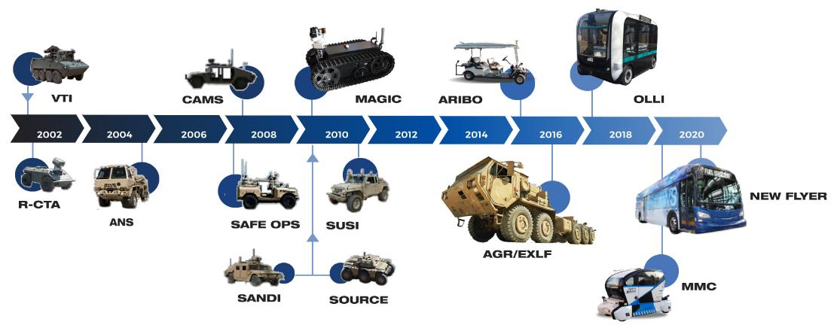
Robotic Research History

Slide 17
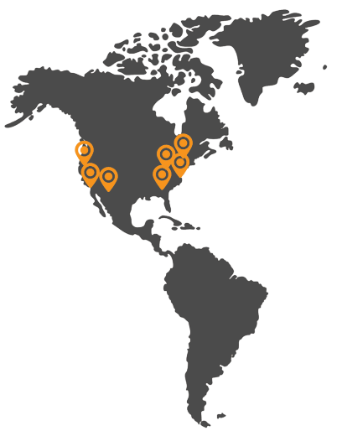
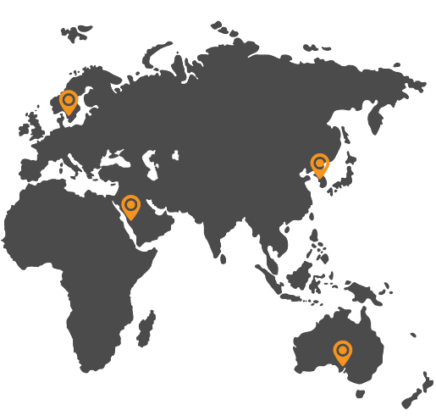

Shuttles Operating on 4 Continents
Adelaide, Australia
Copenhagen, Denmark
Mechelen, Belgium
Seoul, South Korea
Thuwal, Saudi Arabia
Tokyo, Japan
Turin, Italy
Akron, OH
Baltimore, MD
Buffalo, NY
Chandler, AZ
Chicago, IL
Clarksburg, MD
Concord, CA
Fort Myer, VA
Greenville, SC
National Harbor, MD
Peachtree Corners, GA
Phoenix, AZ
Sacramento, CA
San Diego, CA

Slide 18
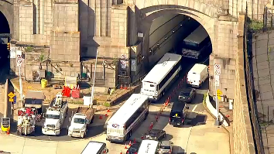
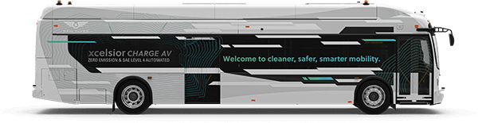
New Flyer - Transit Bus & Coach
Increased Throughput & Efficiency
Traditional Mass Transit
in City
First AV Bus in North America
Precision Docking
Yard Applications
BRT

Slide 19
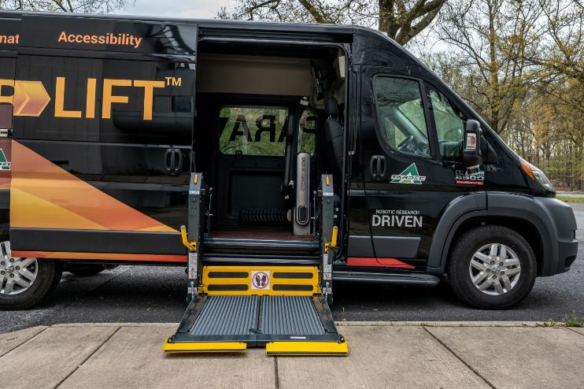
Accessibility in Automated World
Operate without human interaction
Maintain safety of system and surroundings
Accommodate a variety of wheelchair configurations
Perform operations faster than current loading systems
Detect curb/platform

Slide 20
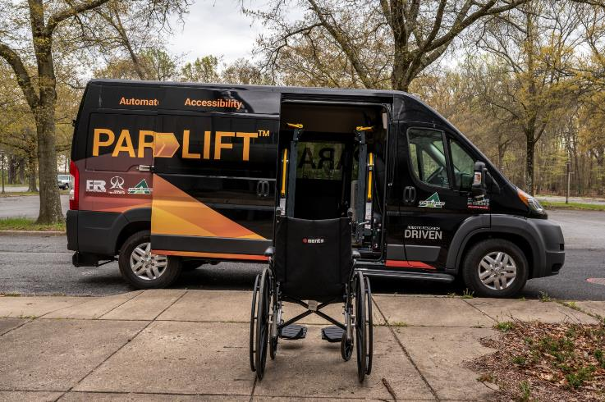
ParaLift Overview
Automatic loading and securement system
Wheelchair passengers enter and exit vehicle with no aid from another person
Intuitive design provides wheelchair passengers with further independence and autonomy in their lives
Features:
Sensing to ensure clear space
Automatic door opener
Powered wheelchair lift
Securement system
Safety system
Announcement system

Slide 21
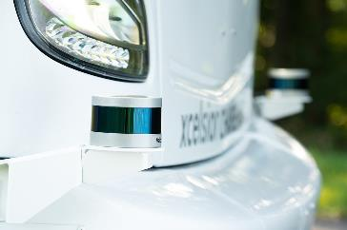
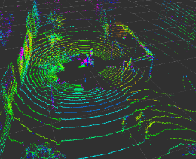
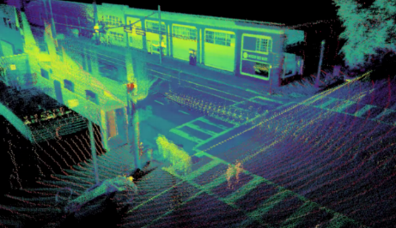
Sensing and Detection
LIDAR sensor generates 3D map of surroundings
Detects the presence of passenger and position of ramp or lift
Ensures area under ramp or lift if clear before lowering
Stops ramp or lift if obstruction
Detect curb and vehicle position
Currently developing camera-based detection system

Slide 22
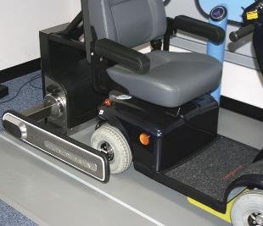
Platform Agnostic
Quantum wheelchair securement system uses a pair of arms to clamp onto wheels of the wheelchair to secure it in place
Three-point seat belt system integration designed to rapidly secure the passenger
Compatible with wheelchairs of various types and sizes
NHTSA crash tested

Slide 23
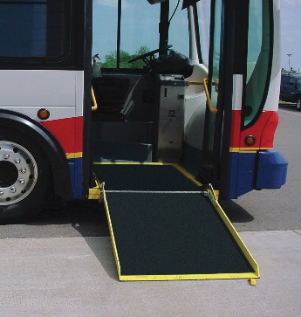
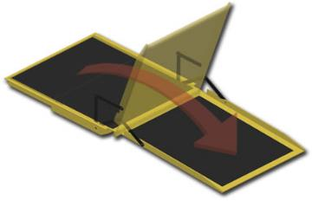
Adaptability
ParaLift can be installed on a variety of commercial vans
Can use existing ramp systems
ParaLift automated system is adaptable to transit buses
Automate control of existing bus ramp and door

Slide 24

Questions

Slide 25

Dr. Kathleen D. Klinich
University of Michigan

Slide 26
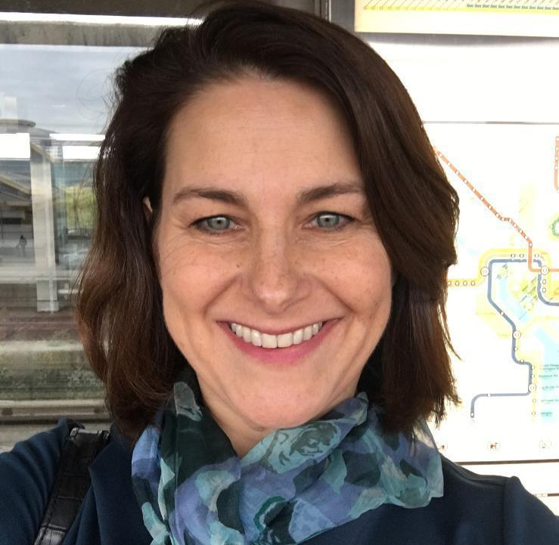
Miriam A. Manary
University of Michigan

Slide 27

Development of an Automated Wheelchair Tiedown and Occupant Restraint System: Initial Progress
Kathleen Klinich, Jingwen Hu,
Miriam Manary, Kyle Boyle, Nichole Orton,
Yushi Wang, Laura Malik, Brian Eby
March 24, 2021

Slide 28
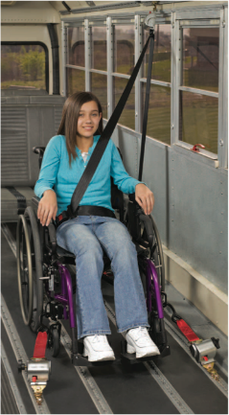
Wheelchair Transportation Safety (WTS)*
Best practice recommendation is to transfer from a wheelchair to a vehicle seat
Wheelchairs used as motor vehicle seats should be crash tested to verify performance (per WC19).
Method to secure the wheelchair to the vehicle. (wheelchair tiedown)
Method to restrain the occupant.
Wheelchair Tiedowns and Occupant Restraint Systems (WTORS)
Ultimate goal of equal level of safety for those who remain seated in wheelchairs.
*Buning, Mary Ellen et al. 2012. “RESNA’s Position on Wheelchairs Used as Seats in Motor Vehicles.” Assistive Technology 24(2).
Notes:
According to the Rehabilitation Engineering Society of North America, a best practice recommendation for people who use wheelchairs is to transfer to a vehicle seat. For situations where a person needs to stay in their wheelchair, they should use a wheelchair that has been crash tested according to voluntary standards. In addition, you need a method to secure the wheelchair to the vehicle, which is referred to as a wheelchair tiedown. You also need a method to restrain the occupant in a crash. These are often referred to as WTORS, or wheelchair tiedowns and occupant restraint systems. The principle behind wheelchair transportation safety recommendations is to achieve an equal level of safety for a person in a wheelchair as experienced by those who are using vehicle seats.

Slide 29
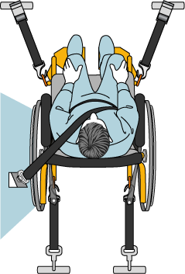
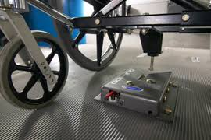
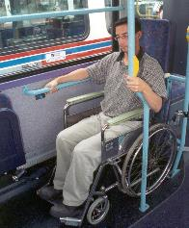
Current WTORS Systems
WTORS Type | Independent Use | Protection in High g and Low g crashes | Any combination of wheelchair and vehicle?
4-pt strap tiedown paired with seatbelt | No | Yes | Yes
Docking station paired with seatbelt | Yes | Yes | No
Rear-facing stations | Yes | No | Yes
Notes:
This chart lists the current types of WTORS that are used and their limitations. The most common type is a 4-point strap tiedown illustrated on the left. While this system can work in high and low severity crashes and can work with any combination of wheelchair and vehicle, a driver or caregiver needs to secure the system, so it is not an option for an automated vehicle that would not have a driver. A docking station shown in the center connects the wheelchair using a bolt that is attached to the wheelchair. This type of tiedown can be used independently in high and low severity crashes, but needs to be customized for a particular combination of wheelchair and vehicle. The rear-facing stations shown on the right allow independent use with any combination of wheelchair and vehicle, but they have not been demonstrated as being safe to use in higher severity crashes.

Slide 30
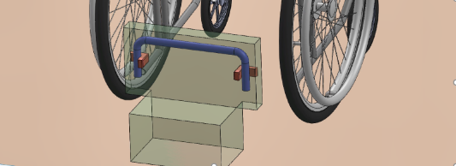
Universal Docking Interface Geometry
Common geometry for connection interface between wheelchairs and vehicles. Akin to standardization of truck trailer hitch.
As long as geometry is met, actual hardware can take any design.
Allows a wheelchair (manual, power, scooter) to dock in any vehicle.
Geometry defined and field tested.
Requires both WC and WTORS manufacturers to work together.
Already implemented in standards, but no commercial use yet.
Notes:
Instead, the approach we are taking to allow safe, independent docking involves developing a docking station that meets Universal Docking Interface Geometry. The concept is illustrated in this animation. The idea is based on the idea of a truck trailer hitch, where any heavy truck cab can connect to any trailer because they both are equipped with hardware meeting a specified geometry. The UDIG concept would allow any wheelchair equipped with compatible attachment hardware to dock in any vehicle equipped with compatible anchorage hardware. The geometry has been defined and field tested and is included in voluntary standards. However, there has been no commercial use yet, because it’s a chicken and the egg situation: we need vehicles with anchorages for it to be useful for wheelchairs to be equipped with attachments, but we need wheelchairs with attachments for it to be useful for vehicles to provide anchorages.

Slide 31
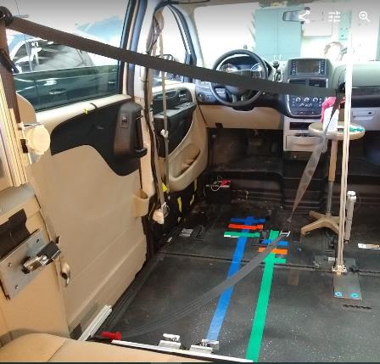
Project Goals and Tasks
Develop an automated wheelchair docking station that would allow safe, independent docking of occupants seated in wheelchairs.
Develop an automated belt-donning system.
Evaluate in front and side impacts.
Computational Modeling
Volunteer Usability Assessment
Sled Testing
Notes:
The need for independent docking options in AV has renewed interest in the UDIG concept. Our project goals are to develop an automated wheelchair docking station that would allow safe, independent docking of occupants seated in wheelchairs. We are also working on developing an automated belt-donning system, and to evaluate the AWTORS under both front and side impact conditions. We are achieving these goals through a combination of computational modeling, volunteer usability assessment, and sled testing.

Slide 32
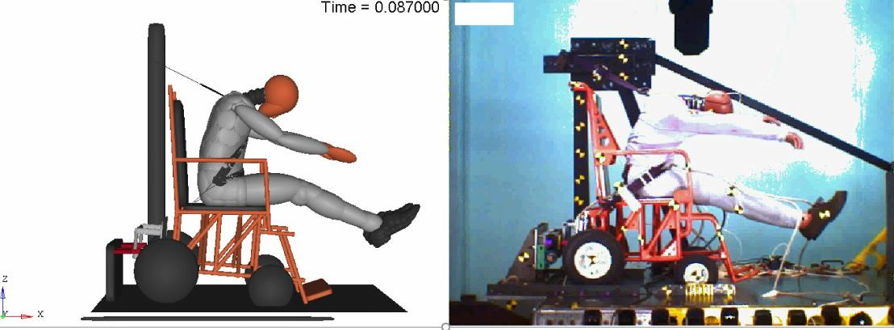
Frontal model validation: surrogate wheelchair fixture
Notes:
This video shows an example of our frontal validated model in comparison to the sled test. This is the surrogate wheelchair used to dynamically test wheelchair tiedowns in voluntary standards, and what we are using to optimize restraint geometry through modeling.

Slide 33
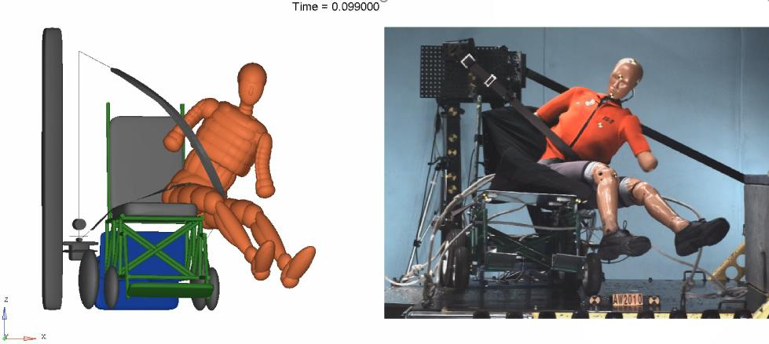
Side model validation
Notes:
Because there are currently no voluntary standards for side impact testing of wheelchairs, chose to use conditions similar to what is proposed for testing child restraints in side impacts. Here is a video of our sled test and validated model. You can see that a challenge in protecting occupants in wheelchairs in far side impacts is that there’s nothing to prevent the occupant from falling out of the wheelchair.

Slide 34
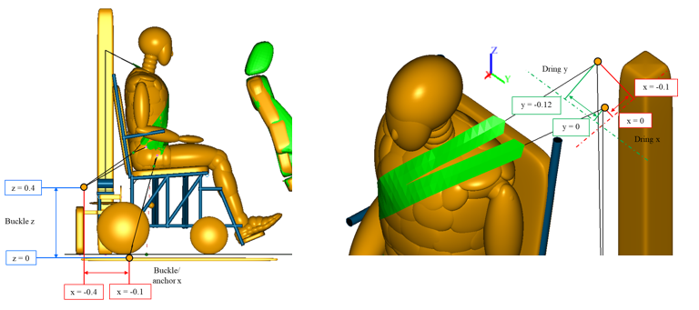
Frontal optimization parameter ranges
Notes:
The main thing we used our models for was to evaluate the geometry of where to place the wheelchair relative to the UDIG anchorages, and where to place the belt anchorages relative to the occupant.

Slide 35
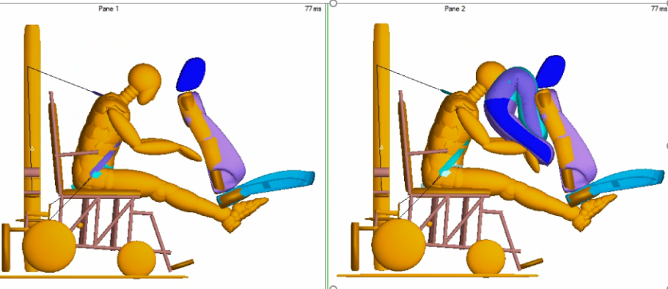
SCARAB airbag
Airbag provides benefit for suboptimal geometry
Providing sufficient space to maneuver wheelchair may reduce potential for head contact
Notes:
We also looked at the potential benefits of airbag restraint for occupants seated in wheelchairs. This SCARAB airbag was designed in a previous research project as an option for protecting rear seat occupants. We found that when you had optimal geometry, the airbag didn’t reduce injury measures substantially. However, if you had suboptimal geometry, such as you might have with a small occupant using belt geometry optimized for a larger occupant, the airbag helped to compensate. The other thing we found is that if your wheelchair seating station meets the required space of 30 x 48 inches, the chances of head occupant for a midsized male with optimal geometry are small. So providing enough space to maneuver a wheelchair might reduce the potential for head contact.

Slide 36
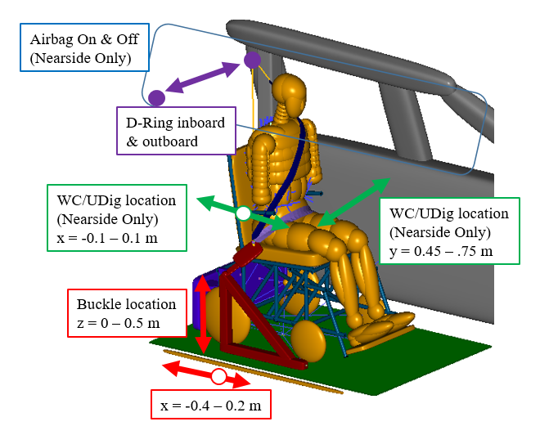
Side impact optimization
Notes:
For side impact modeling, explored location of the occupant relative to curtain airbags, belt geometry, and alternative D-ring locations. We couldn’t come up with a good solution using just belts and a standard curtain airbag to protect occupants in wheelchairs in both near and farside impacts.

Slide 37
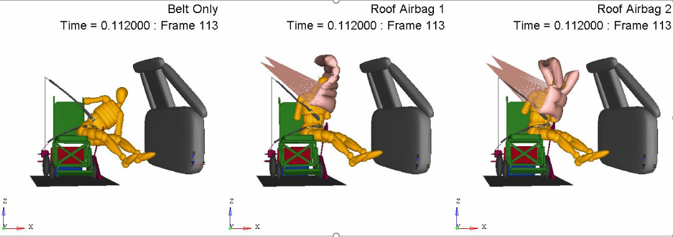
Concept: Center Airbag To Contain Humans (CATCH)
Notes:
Because of this, we turned to our collaborators at ZF to see if we could identify a solution using an airbag. They were able to design what we’re calling a Center Airbag to Contain Humans that can CATCH a farside occupant in a wheelchair using an innovative tethering strategy. The difference between the center and right designs is the addition of a window that might reduce neck loading. ZF is working to construct prototypes that we will evaluate with sled testing this spring.

Slide 38
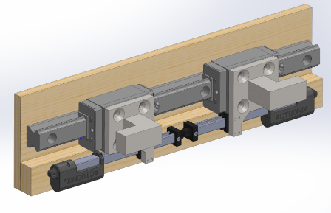
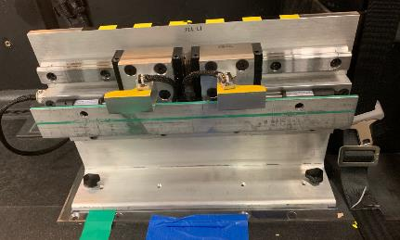
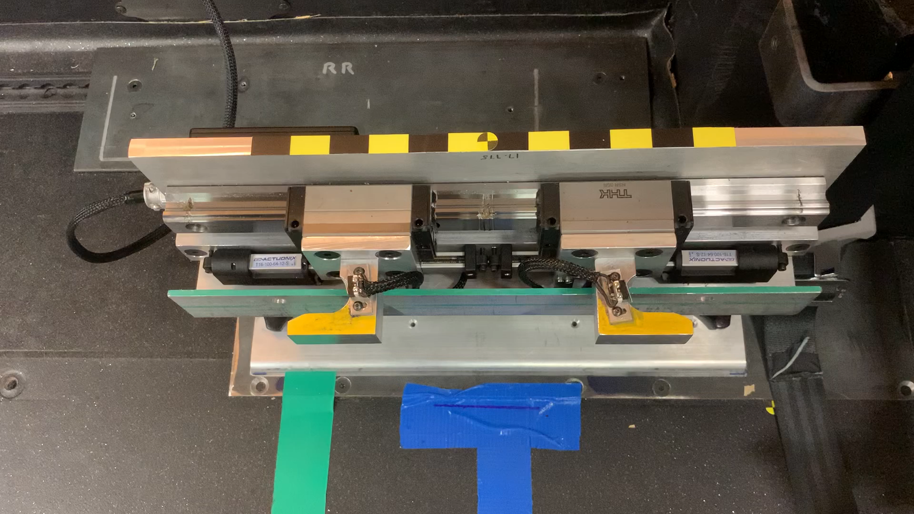
UDIG Anchorages
Notes:
This is the design of the UDIG compatible vehicle anchorage we are evaluating with volunteers. As you can see in the video, the occupant would back up their wheelchair so the attachments are touching the surface marked with a green line on the top. They would then push a button to activate the hooks to move outward and engage with the attachments. The two hooks operate independently so the system works even if the occupant is not exactly centered relative to the anchorages.

Slide 39
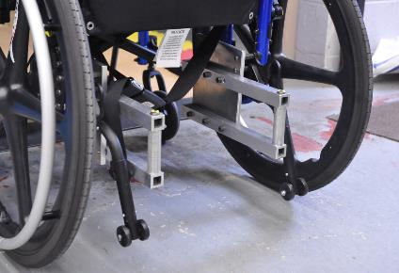
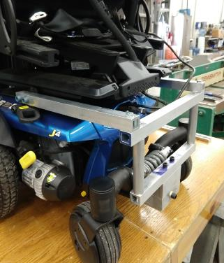
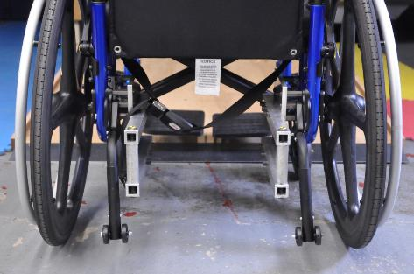
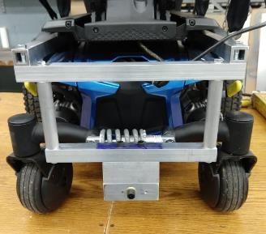
Wheelchair UDIG attachments
Notes:
These are photos of the UDIG compatible attachments we designed for a manual and power wheelchair. As you can see the critical common geometry are the two vertical bars, but the method of connecting the bars to the wheelchairs depends on the structure of the wheelchair. We aimed to connect the attachments near the locations of the hooks used with 4-pt strap tiedowns, since we know those areas have been crash tested. Initial feedback on the designs is that they are should be smaller and more integrated into the wheelchair design. We want to emphasize that we need to get the system working with some wheelchairs before we can get it working with all wheelchairs, and the next phase will involve efforts to minimize their size and make them more integrated.

Slide 40
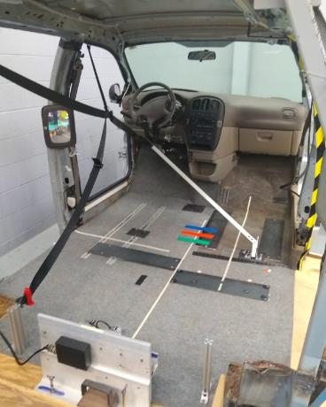
Key goals of volunteer testing
How do different seating station configurations affect accessibility?
How do different belt geometries affect fit, comfort, and usability?
How much variation in belt fit do we get between power and manual wheelchairs in the same condition?
Feedback from regular wheelchair users on usability.
Notes:
We are evaluating different wheelchair seating station geometries and our belt donning system with volunteers who are regular wheelchair users, but are able to transfer to our wheelchairs that have the UDIG attachments on them. What we are trying to determine is how accessible different configurations are, and how do different belt geometries affect fit, comfort, and usability. In particular, we want to know how much variation in belt fit we get between our power wheelchair and our manual wheelchair in the same condition, because their dimensions position the occupant differently. We also want to obtain feedback from potential users of the system on how easy it is to use.

Slide 41
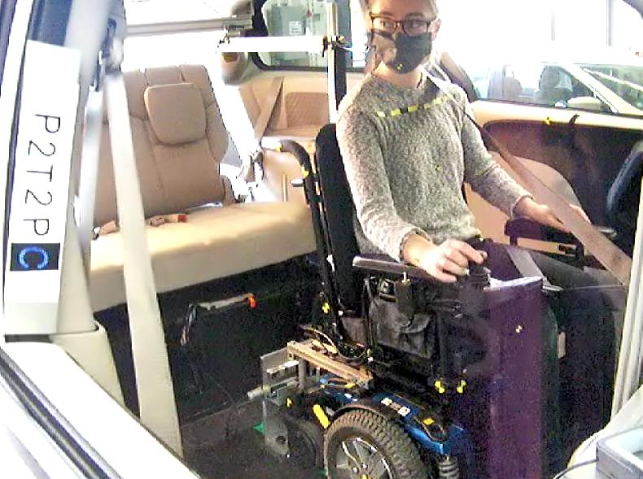
Pilot testing
Notes:
This is a video of a pilot test of one of my colleagues. She first maneuvers the wheelchair into position, lining the wheelchair up with a centerline marked on the floor. We also have a gopro mounted to provide a view of the anchorages. Once she is lined up, she pushes a button to activate the anchorages. She then pushes another control, and an arm rotates down to position the seatbelt around the occupant. Things we know a real implementation would need to include are options for voice control, an indicator to tell when you are fully engaged, and a way to snug the belts automatically.

Slide 42
More information coming
Project finishing up in June
Save the date-Thursday August 5, 2021 1-4 pm
Virtual Open House to share findings from this research
umtri.umich.edu for more information this summer

Slide 43
We would like to thank the National Highway Traffic Safety Administration for sponsoring this project.
Thank you for your attention.
Kathleen D. Klinich kklinich@Umich.edu
Miriam A. Manary mmanary@umich.edu
Notes:
We would like to thank NHTSA for sponsoring this project. If you have any questions, please direct them to my email listed here. Thank you for your attention.

Slide 44
Questions?

Slide 45

Dr. Jordana Maisel
University at Buffalo

Slide 46
Accessibility for Passengers with Mobility Disabilities: Part 2 Maneuvering and securement
Jordana L. Maisel, PhD
U.S. Access Board Public Forum on Autonomous Vehicles
Notes:
Good Afternoon.
I’d like to start by thanking the U.S. Access Board for hosting this important 4-part series; Randall Ducheseau and Scott Windley for coordinating and inviting me to speak, and all of you for taking the time to join us today.
As Scott mentioned, my name is Jordana Maisel and I direct the research at the IDEA Center at the University at Buffalo, where we have been engaged in over a decade of research related to accessible public transportation.
Today, I want to briefly share some of the research my colleagues and I have conducted, specifically related to maneuvering and securement on fixed-route buses. I believe much of this work is applicable to our current discussion on self-driving vehicles. I look forward to a great discussion.

Slide 47
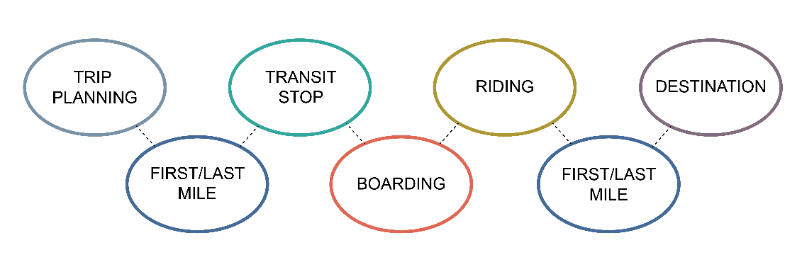
Travel Chain
Notes:
The image on the screen is a crude interpretation of the Travel Chain. The seven colored circles correspond to the key elements necessary to complete a trip: Trip Planning, First/Last Mile, Transit Stop, Boarding, Riding, First/Last Mile, Destination.
I share this image because it came up during the first forum and I think it’s worth emphasizing—while I’m focusing on the Riding link in the Travel Chain today (and we focused on Boarding last week), a true accessible and inclusive trip and transportation system, which is the ultimate goal, is only achieved if we address the entire Chain.

Slide 48
Research Questions
How does seating configuration impact interior movement and usability for individuals who use wheeled mobility devices, are blind and/or visually impaired, and who use walking aids?
How do different securement systems affect securement time and usability for people who use different types of wheeled mobility devices?
How does field testing newer (i.e., 3-point, forward-facing and semi-automated, rear-facing) securement systems impact usability for manual wheelchair users, power wheelchair users, and scooter users?
Notes:
The three major research questions we explored were:
How does seating configuration impact interior movement and usability for individuals who use wheeled mobility devices, are blind and/or visually impaired, and who use walking aids?
How do different securement systems affect securement time and usability for people who use different types of wheeled mobility devices?
How does field testing newer (i.e., 3-point, forward-facing and semi-automated, rear-facing) securement systems impact usability for manual wheelchair users, power wheelchair users, and scooter users?

Slide 49
Interior Seating Layout
Notes:
With this study, we used a full-scale simulated bus to explore reconfigurable seating layouts
We also incorporated the use of manikins to occupy seats, in order to simulate crowding conditions.

Slide 50
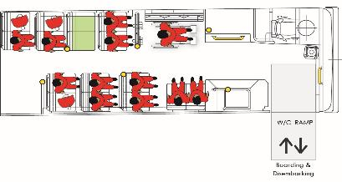
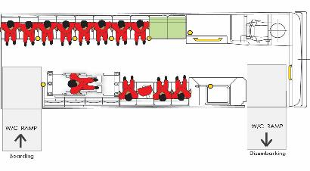
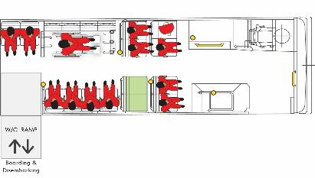
Research Design — Layouts
Layout 1:
Front Entry/Exit
Forward Seating
Layout 2:
Mid Entry, Front Exit
Side Seating
Layout 3
Mid Entry, Mid Exit
Mixed Seating
Notes:
The 3 images on the slide reflect the 3 layouts that were tested in the lab. Bus layout 1 (the drawing on the left) included an access ramp in the front doorway, two spaces for wheelchair securement immediately behind the front wheel-wells, and forward facing seats throughout the remainder of the bus interior. This layout is very typical of low-floor buses used in many U.S. cities
Bus layout 2 (shown in the middle of your screen) included ramps located at the front and rear doorways, side-facing seats along the sides of the bus interior and two spaces located along the curb side of the bus for wheelchair securement. The rear doorway was used for boarding, and the front door for alighting.
Bus layout 3 included an access ramp located at the rear doorway, a wheelchair securement space on the road side and curb side of the bus to the right of the doorway, and forward facing seats throughout the remainder of the bus interior.
For each of the bus layouts, two levels of crowding were simulated using seated mannequins – high crowding where only one pair of seats were available restricting seating choice, and low crowding where only half the number of seats were occupied.
The layout order was counter-balanced across participants and crowding condition within layout was randomized.

Slide 51
Research Design — Task Description
Ramp Ascent
Fare Payment
Moving to the Seat/Wheelchair Securement Space (WSC)
Entering and Positioning
Exiting the Seat/WSC
Moving to the Exit Door
Ramp Descent
Notes:
Study participants evaluated each of the six conditions by undertaking a simulated bus journey that included boarding from a sidewalk, fare payment using a smart-card, locating and moving to a vacant seat, getting into and out of the seat, moving to the exit door and alighting
The drawing on the screen shows a plan view of the bus interior with the 7 tasks numbered in order of completion:
Following each journey, participants were asked to provide ratings of design related to the configurations and then interviewed to assess their difficulty in completing various aspects of the journey. Movements were recorded using conventional video cameras and a three-dimensional active marker motion capture system.

Slide 52
Study Sample (n=90)
Participant Group | n
Wheeled Mobility Device Users | 48
Blind, Visual Impairment | 18
Walking Aid Users | 24
Notes:
The study had 90 total participants included 48 WMD users, 18 individuals who were blind/VI and 24 Walking aid users.

Slide 53

Findings — WhMD Users (n=48)
Narrow turning space near the front of the bus.
Inadequate turning space with second wheelchair on board.
Side-facing seats less desirable; increased risk of injuring others.
Limited reach capability among wheeled mobility users.
Notes:
The photo on the left is of a manual chair user making the turn from the fare payment machine towards the bus aisle.
For the wheeled mobility device users, the main findings were that:
Many experienced challenges with the narrow turning space near the front of the bus in layout 1
This was particularly challenging when there was a second person on the vehicle, occupying the securement space.
The side-facing seats were less desirable as it caused an increased sense of fear and risk of injuring others.
And, many participants had limited reach capability to access the fare payment machine.

Slide 54

Findings — BVI (n=18) and WA Users (n=24)
Side-facing seats preferred.
Challenges locating features in the environment, e.g., fare payment, vacant seat.
Risk of collisions, trip hazards.
Use of assistive supports during sitting and rising.
Notes:
The photo on the left is of a blind participant standing at the fare payment machine.
A large majority of our blind and walking aid user participants preferred side-facing seats over the front-facing seats. Commonly cited reasons were “more legroom”, “ease of getting in to and out of the seat”, “wider aisle” and “more room for luggage”.
Many participants also expressed challenges with orientation and mobility, citing difficulty locating features in the environment such as the fare payment machine and vacant seats.
The study also showed the need for adequate device storage space and the importance of support features like handrails and vertical stanchions during ambulation and seating by people with mobility limitations.

Slide 55

Summary
Environment design impacted performance.
Space requirements for walking aid users.
Increasing minimum clearances by small amount will increase the percentage of people accommodated, particularly wheeled mobility users.
There will not be “one best solution” to accessibility.
Everything is interrelated, e.g. fare location and maneuvering, entry location, and stop design.
Notes:
Ultimately, the findings confirmed that the interior environment of the vehicle impacted performance. And, this performance was further influenced by participants’ disability and the crowding condition.
Specifically, with respect to walking aid users, the side-facing seating orientation was preferred. These users still expressed concerns for having sufficient storage space for their device.
We also know (from some of our other research as well) that there is a need for greater clearances for maneuvering and securement as evidenced by changing wheelchair dimensions. We also know that increasing these clearances just slightly can have a great impact on usability.
I think it’s important to highlight that it’s unlikely that there will be one best solution for solving the challenges with the interior layout. As you saw, solutions for some user groups will have unintended consequences for others.
And, it is important to remember that the riding experience is a series of interrelated components: the design of the fare payment system (which may become obsolete as we move towards digital/app based payment), the entry location, the seating configuration, the stop design, etc. are all connected and impact the ride experience.

Slide 56
Securement (Lab)
Notes:
Switching gears, I want to briefly discuss a lab study we conducted that explored the usability of three different securement systems under ideal, test conditions.
Before I do that, I Just was to provide a little background for context:
ADA-compliant buses must have two wheelchair securement areas, and a seat belt and shoulder harness to secure the wheelchair user (Part 38 DOT ADA regulation).
It is up to the transit authority to require the use of the wheelchair securement, and use of seatbelts and shoulder harnesses is voluntary.
Proper use of securement systems requires identifying appropriate attachment points on the wheelchairs. Newer wheelchairs that comply with the ANSI/RESNA WC19 standard come equipped with attachment points as metal rings on the chassis for this purpose.
Despite many advances, the practice of wheelchair securement remains low at around 39% (Buning et al., 2007).

Slide 57



Research Design — Securement (n=36)
Participant Group | n
Manual Wheelchair | 15
Power Wheelchair | 15
Scooter | 6
4-Point
3-Point Forward-Facing
(3P-FF)
Semi-Automated Rear-Facing
(SA-RF)
Notes:
This study had 36 participants, 15 MWC, 15, PWC, and 6 SC
We tested three different securement types, the first (the image on the left) is of a 4-PT, traditional, tie down system, which is the most common
48” x 30” area (ADA minimum)
Forward-facing position
4 retractable restraints:
2 located in the front on floor mounted arm
2 located in the rear on a barrier panel
The image in the middle is the 3-point, forward-facing (3P-FF) system. It has two tie down straps mounted on the rear-barrier, and the third one on the front corner of the seating component. The front side lever located adjacent to the wheel well fully engages and releases the tension of the front tie down. The securement system is equipped with three-passenger flip seats, and the occupant restraint system is integrated into the rear barrier. The securement area measured from the front wheel well to the footrest of the rear-barrier is 52 inches long by a minimum of 30 inches wide (132.1 cm x 76.2 cm).
The image on the right is of a semi-automated, rear-facing (SA-RF) system. It is an electromechanical system whereby securement is physically achieved using two horizontal arms (30.5 inches long). The distance from the backrest to the footrest of the rear-barrier is 51 inches (129.5 cm). The occupant restraint system is mounted on the vehicle wall near the backrest. Three self-rising passenger seats and armrests are installed against the bus wall. The passenger control button and the instruction board are located underneath the middle, wall-mounted passenger seat.

Slide 58

Findings — Time, All Participants
Securement Only
Total Time
Notes:
On the left of this slide is a line drawing showing Securement time for each of the three securement types, stratified by participant group. The line graph on the right shows the same thing but for total time, which includes boarding, maneuvering into space, securing, and alighting.
Findings show that securement type had a significant effect on time. The 4-point system took significantly longer to secure than the 3P-FF, and the SA-RF was significantly faster than both the 4-point and 3P-FF systems. There was no statistically significant difference in total time between the 3P-FF and 4-point systems.

Slide 59
Preferences
Groups | N | Participant Preference
 |  | 4-Point | 3P-FF | SA-RF
MWC | 15 | 3 | 3 | 9
PWC | 15* | 2 | 2 | 10
Scooter | 6 | 0 | 0 | 6
*Note: One PWC did not specify a preference for a single securement system.
Notes:
We asked participants for their preferred securement system. Interestingly enough, MWC were split across the three securement types with 3 preferring the 4-pt, 3 preferring the 3P-FF, and the SA-RF being most preferred with 9 participants.
This was quite similar for PWC.
But all 6 scooter users said they preferred the SA-RF system. I highlight this because this was the primary difference between our lab and field study.

Slide 60
Securement (FIELD)
Notes:
We then field-tested the two newer securement systems in order to determine if usability findings in the lab generalize to everyday transit conditions that include time pressures, crowding, and interactions with professional bus operators.
Studying the usability of the 3P-FF securement system was also important since the ADA mandates transit agencies make at least one of the two designated securement spaces on fixed-route buses forward-facing, and recent industry trends suggest increased adoption of this securement type.
These two securement systems do not require wheelchairs to have special adaptors..

Slide 61


Research Design (n=40)
Participant Group | n | Age Range
Manual Wheelchair | 14 | 28-71
Power Wheelchair | 19 | 32-74
Scooter | 7 | 38-65
3P-FF
SA-RF
Notes:
We collaborated with our local transit agency, the Niagara Frontier Transportation Authority (NFTA), to use low-floor buses in regular service for this study.
The NFTA retrofitted three of these low-floor buses with both the 3P-FF and SA-RF securement systems. The image on the left is of a manual wheelchair user secured using the 3P-FF system while the image on the right is of a power wheelchair user secured using the SA-RF.
Three groups of wheelchair users (14 manual wheelchair [MWC], 19 power wheelchair [PWC], and 7 scooter [SC] users; n=40) completed a pre-study interview, four trips on the vehicle with accompanying surveys, and a final interview.

Slide 62

Findings — Difficulty/Acceptability
Notes:
This image shows two sets of box plots. On the left is a box plot showing the perceived level of difficulty, stratified by participant group and securement type. The box plot on the right shows the same thing for level of perceived acceptability of the various securement types.
Findings indicated clear differences in ratings of difficulty and acceptability between securement systems by wheelchair user group, with the SA-RF outperforming the 3P-FF on most usability measures for MWC and PWC users. SC users consistently rated both securement systems as more difficult to use and the SA-RF securement as less acceptable than MWC and PWC users.

Slide 63

Findings — RAPUUD, Securement Device
Notes:
These two radar plots shows participant responses to the RAPUUD tool, stratified by securement type and user group. RAPUUD stands for the Rapid Assessment for Product Usability and Universal Design. This tool includes a series of self-reported usability measures such as low physical and mental effort, level of independence, ease of use, low unwanted attention, low safety risk, low mistakes, low embarrassment and time efficiency. The larger areas in the radar chart indicate more favorable median ratings on the RAPUUD.
The image on the left shows the results for the 3P-FF. This system was rated similarly across user groups.
The image on the right shows the results for the SA-RF. In this case, there was some variability across the user groups, with the MWC and PWC users scoring high across almost all of the usability dimensions. Scooter users only reported high levels of usability related to independence and low safety risk. SC users rated both the 3P-FF and SA-RF securement systems as resulting in more mistakes than MWC users (p = .003) and requiring greater physical effort than MWC

Slide 64

Findings — Rear-Facing
Notes:
Other questions asked participants to specifically rate features of the rear-facing system (e.g., motion sickness, unwanted attention, navigation) using a 5-point Likert scale (e.g., strongly disagree to strongly agree).
With respect to common issues associated with rear-facing systems, participants (n = 38) across user groups agreed that they felt little motion sickness, felt safe while riding, and felt that it was easy to get into the securement area and easy to secure the wheelchair.
Some participants expressed that the rear-facing system made it difficult to identify where the bus was going and where to get off.
I think it’s also important to highlight that the acceptability rating for rear-facing orientation increased after using the securement system among MWC and PWC users, but negatively changes for SC users after they used the system.

Slide 65
Summary of Findings
A slight majority preferred the SA-RF system to the 3P-FF system.
Although MWC and PWC users rated the use of the SA-RF favorably on many measures, participants in this field study were less likely to prefer the SA-RF.
SC users consistently rated both securement systems as more difficult to use and requiring greater physical effort than MWC and PWC users.
PWC and SC users were almost evenly divided between using fixed-route more or less often due to the presence of the SA-RF.
Design research is needed to explore the capacity for scooters to be secured (rear-facing) safely in public transportation vehicles.
Notes:
Although a slight majority of participants preferred the SA-RF system to the 3P-FF system, SC users consistently rated both securement systems as more difficult to use and requiring greater physical effort than MWC and PWC users. One reason for these differences in ratings could be due to compatibility issues between the scooter devices and the SA-RF in the field.
Overall, compared to the lab study, participants were less likely to prefer the SA-RF in the field study. Potential reasons for these differences include challenges associated with wheelchair alignment in the given securement space in the field, which was two inches shorter than the space defined in the lab; discomfort facing other passengers; the pressure of on-time departures; and, perhaps a reduction in stability or ability to counteract accelerations or decelerations while rear-facing during travel.
PWC and SC users were almost evenly divided between using the fixed-route bus more or less often due to the presence of the SA-RF. This reflects the split responses on participants either highly liking or disliking the system.
Design research is needed to explore the capacity for scooters to be secured (rear-facing) safely in public transportation vehicles.

Slide 66
Research Implications for Self-Driving Vehicles
Maneuvering and securing in public transportation are challenging for individuals with mobility and sensory impairments.
Need for greater clearances for maneuvering and securement as evidenced by changing wheelchair dimensions.
Reconfigurable spaces/seating will need to accommodate a wide range of rider needs and preferences.
Fare payment tasks add to the challenges and should be eliminated during trips.
Audio and tactile communication may assist those who are blind or have visual impairments more effectively way find within the vehicles.
Sensing of passenger status (located properly, secured, etc.) will be important.
Independent wheelchair securement requires significant space and designs that accommodate diverse mobility devices.
Notes:
Although our research did not explicitly look at maneuvering and securement in self-driving vehicles, many of the findings can be applied when designing these new systems.
Maneuvering and securing in public transportation are challenging for individuals with mobility and sensory impairments (e.g., time consuming, level of difficulty).
Reconfigurable spaces/seating will need to accommodate a wide range of rider needs and preferences.
Fare payment tasks add to the challenges and should be eliminated during trips—which I think we’re on the way to doing; however, we need to ensure any new payment system provides an equitable solution to address the needs of those without banking and access to smartphones.
Audio and tactile communication may assist those who are blind or have visual impairments more effectively way find within the vehicles. Furthermore, sensing of passenger status (located properly, secured, etc.) will be important. (I think these topics will be further discussed during the next forum)
Finally, independent wheelchair securement requires significant space and designs that accommodate diverse mobility devices.

Slide 67
Sponsor
This presentation was funded in part by grants from the National Institute on Disability, Independent Living, and Rehabilitation Research (NIDILRR) grant numbers H133E080019, 90IFRE0010, and 90RE5011. NIDILRR is a Center within the Administration for Community Living (ACL), Department of Health and Human Services (HHS). The contents of this presentation do not necessarily represent the policy of NIDILRR, ACL, HHS, and you should not assume endorsement by the Federal Government.

Slide 68
Questions/Comments
Jordana L. Maisel, PhD
Center for Inclusive Design and Environmental Access
University at Buffalo School of Architecture and Planning
309 Hayes Hall | 3435 Main St. | Buffalo, NY 14214-8030
jlmaisel@buffalo.edu
idea.ap.buffalo.edu

Slide 69

Open Discussion
Request to share information, ideas, or comments using Zoom’s Q & A feature:
Microphone – you will be allowed to speak
Question – you will not speak, (moderator will read question)
Name (and organization)
Brief description of content
Host will enter you into queue
Moderator will announce when you should unmute (*6 by phone)
Moderator will also announce next in que
Presenters may respond to some comments
Alternative: events@access-board.gov
ASL – note in request to comment
Please limit comments to < 2 min.

Slide 70

Online Dialogue
Continue the conversation Online
http://transportationinnovation.ideascale.com
Share ideas, comment, vote
For assistance, email: ePolicyWorks@dol.gov

Slide 71
Next Session
Accessibility for Passengers with Sensory and Cognitive Disabilities: Part 1
This session will address ride hailing and on-board communication for passengers with hearing, visual, or cognitive disabilities.
April 7, 2021, 2:00 – 3:30 (ET)
Presenters:
Hendrik Opstelten – Federal Transit Administration (FTA)
Anil Lewis – National Federation of the Blind (NFB)
Dr. Robin Brewer, University of Michigan
Dr. Christian Vogler, Gallaudet University

